Slide 1

UNIVERSITY INSTITUTE OF COMPUTING
Agile Methodology
(24CAT-656)

Slide 2
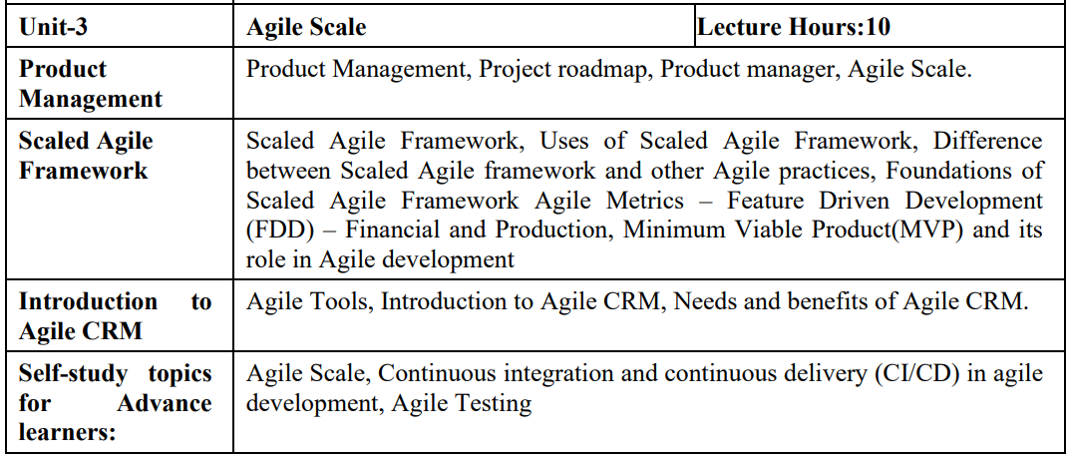
SYLLABUS
2

Slide 3
CONTENT OF THE SYLLABUS
TEXT BOOKS
T1 David J. Anderson and Eli Schragenheim, Agile Management for Software Engineering: Applying the Theory of Constraints for Business Results, Prentice Hall, 2003.
T2 Hazza and Dubinsky, Agile Software Engineering, Series: Undergraduate Topics in Computer Science, Springer, 2009.
T3 Agile Software Development Ecosystems by Jim Highsmith, Addison-Wesley 2002, ISBN 0201760436.
REFERENCES
R1 Craig Larman, Agile and Iterative Development: A Managers Guide, Addison-Wesley, 2004.
R2 Kevin C. Desouza, Agile Information Systems: Conceptualization, Construction, and Management, Butterworth-Heinemann, 2007.
3

Slide 4
Agile CRM
Agile CRM (Customer Relationship Management) is an All-in-One CRM with Sales, Service automation, and Marketing in a single platform. It consists of sales tracking, marketing automation, contact management, web analytics, telephony, two-way emails, and helpdesk with a simple, clean, and modern interface.
Customer Relationship Management or CRM is software that helps in managing the brand's engagement with your current and future customer.
The CRM software allows you to build, organize, and present database of your customer information. This information can be updated by you and your team when the new data is discovered. It is a central storehouse of all your customer and prospect information which facilitates your team to be organized and more productive. It also allows teamwork among teams and provides management to deeper judgment into individual performance and overall growth of the business.
4

Slide 5
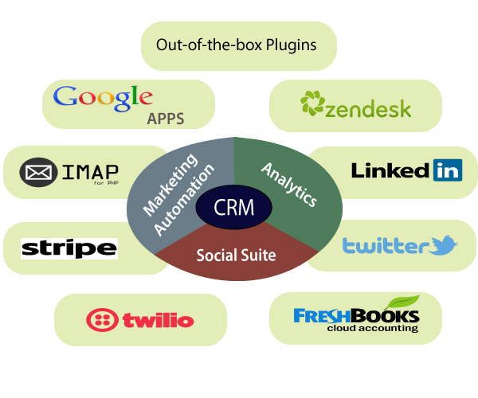
Agile CRM
5

Slide 6
Why we built Agile CRM
As an entrepreneur, everyone wants to receive positive feedback and increasing the new product's success.
From the first few customers, you engage them with their name, knowing them well enough to talk to them multiple times a day.
After that, they may help you to share your product to where it stands. Then, you will get more success, but more trouble also to manage the communication with all of your customers.
6

Slide 7
Need of Agile CRM
The primary requirement of Agile CRM is broken down into the following points:
Easy-to-use marketing automation: This is easy to use because not every owner of a small businesses should need to understand the technical details of automation.
A manageable CRM: it is easy to use and affordable.
Telephony: There was probably nothing more annoying than seeing someone's phone number on CRM and then dialing their number on our phone. We spent a lot of time in solving our cell phone plans too!
7

Slide 8
Need of Agile CRM
Social suite: Social media playing a vital role in CRM marketing and linking customer with it. If the business owner doesn't incorporate with social media at the very beginning, then they would be left behind.
Full, two-way email integration: The owner wants to integrate personal emails fully into the CRM. So, they can send, receive, and view emails between the owner and their customers inside the CRM itself.
8

Slide 9
Benefit of Agile CRM
The significant benefit of CRM is that the business moves to the centralized platform to store its data. It makes easy access to information from one common source. Due to the presence of best CRM, the organization gets confident to pay attention to their customer without any additional cost.
Before the availability of CRM, the data has scattered across spreadsheets, documents, address book, notebook, and email system. The CRM, simplify this tedious process, and data are access through a centralized location.
9

Slide 10
THANK YOU
For Queries:- ramanjeetsingh.uic@cumail.in

